Slide 1
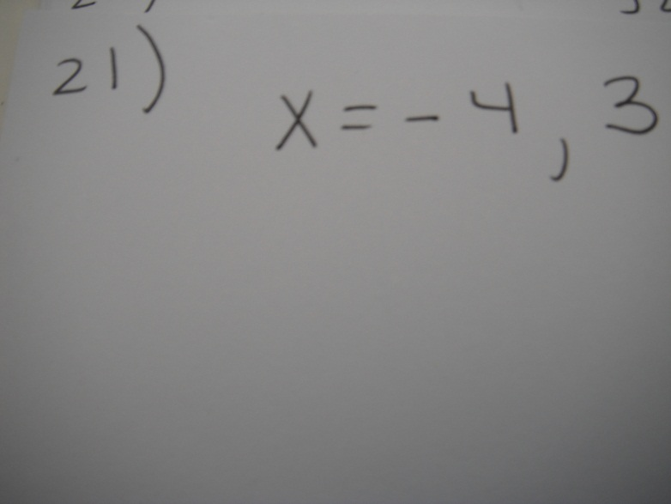

21. What is to be the solutions of the system of equations shown in the graph?

Slide 2
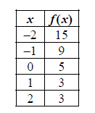
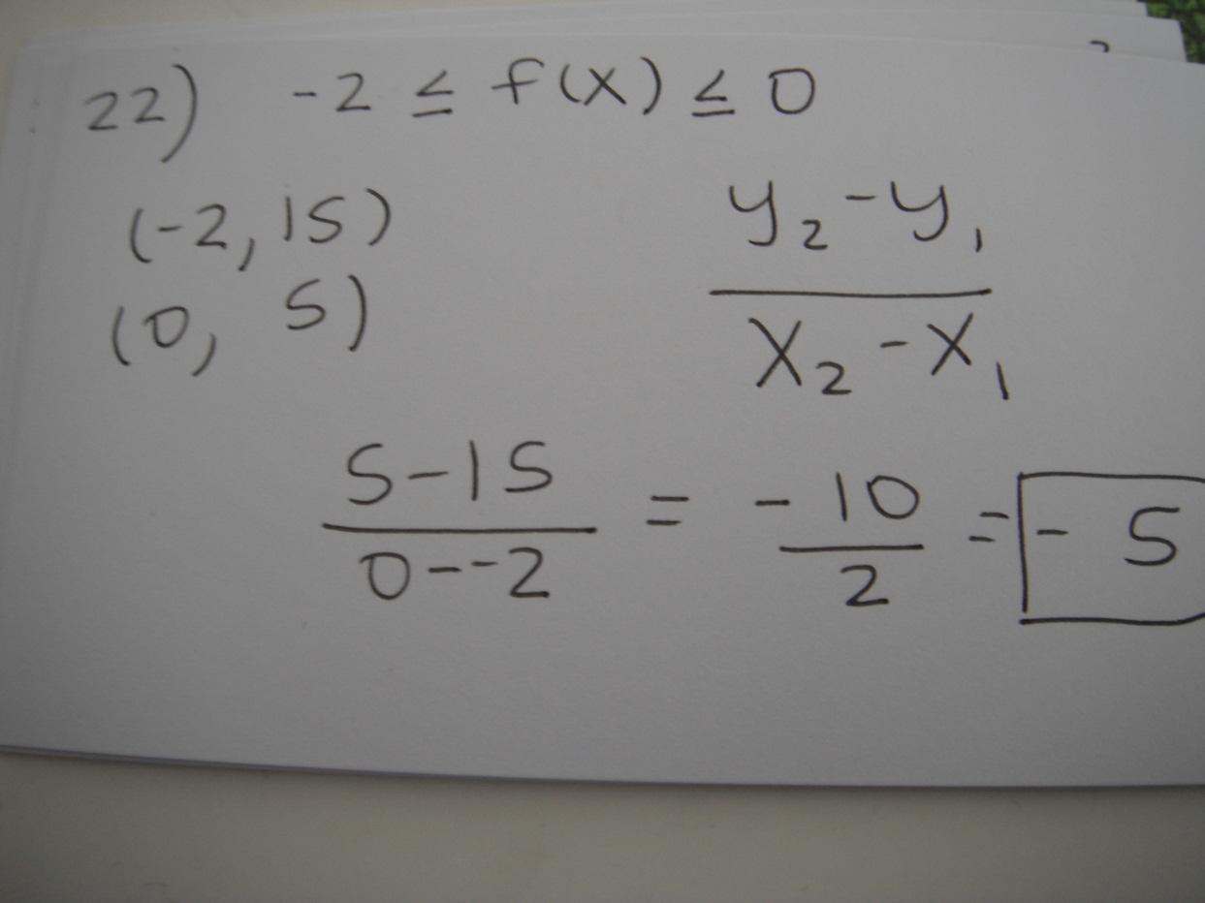
22. Use this table to answer the question.
What is the average rate of change of f(x) over
the interval –2 ≤ f(x) ≤ 0?

Slide 3
23. Is f(x) = 2x³ + 6x even, odd, or neither? Explain how you know.
Answer: it is odd because the exponents are both odd numbers. If they were all even numbers then the function would be even. If the exponents were a mix of even and odd numbers, then the function would be neither odd nor even.

Slide 4
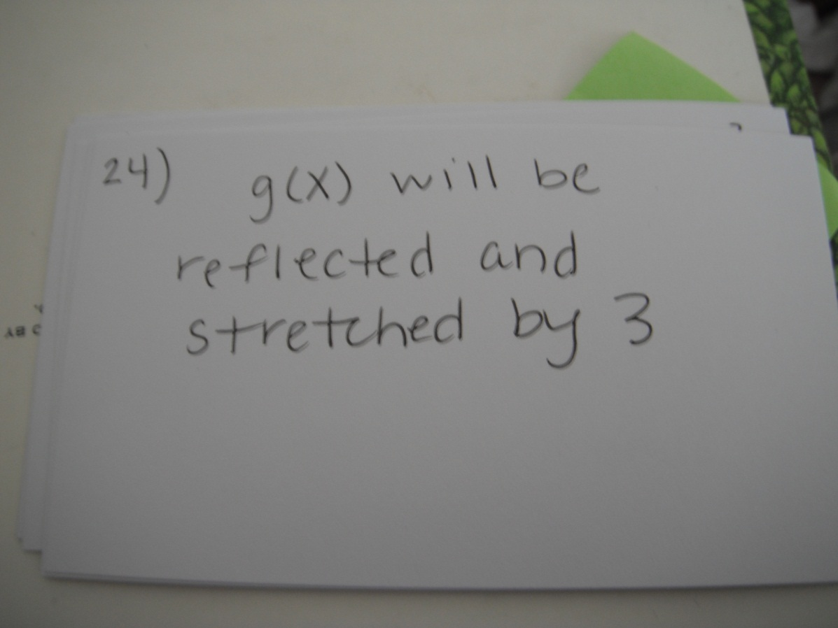
24. How does the graph of g(x) = –3x² compare to the graph of f(x) = x²?

Slide 5
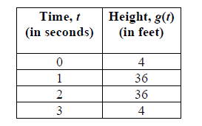
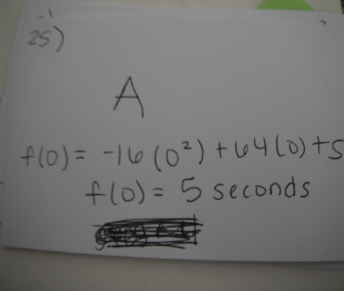
25. The function f(t) = –16t² + 64t + 5 models the height of a ball that was hit into the air, where t is measured in seconds and h is the height in feet.
This table represents the height, g(t), of a second ball that was thrown into the air.
Which statement BEST compares the length of time each ball is in the air?
A. The ball represented by f(t) is in the air for about 5 seconds, and the ball represented by
g(t) is in the air for about 3 seconds.
B. The ball represented by f(t) is in the air for about 3 seconds, and the ball represented by
g(t) is in the air for about 5 seconds.
C. The ball represented by f(t) is in the air for about 3 seconds, and the ball represented by
g(t) is in the air for about 4 seconds.
D. The ball represented by f(t) is in the air for about 4 seconds, and the ball represented by
g(t) is in the air for about 3 seconds.

Slide 6
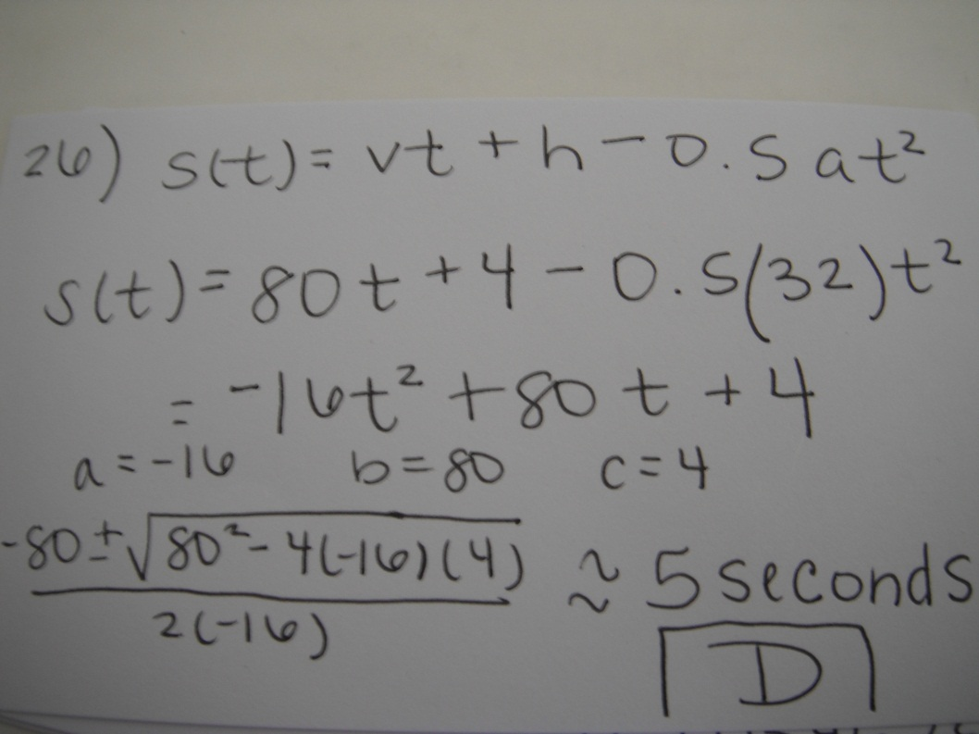
26. The function s(t) = vt + h – 0.5at² represents the height of an object, s, from the ground after time, t, when the object is thrown with an initial velocity of v, at an initial height of h, and where a is the acceleration due to gravity (32 feet per second squared).A baseball player hits a baseball 4 feet above the ground with an initial velocity of 80 feet per second. About how long will it take the baseball to hit the ground?
A. 2 seconds B. 3 seconds C. 4 seconds D. 5 seconds

Slide 7
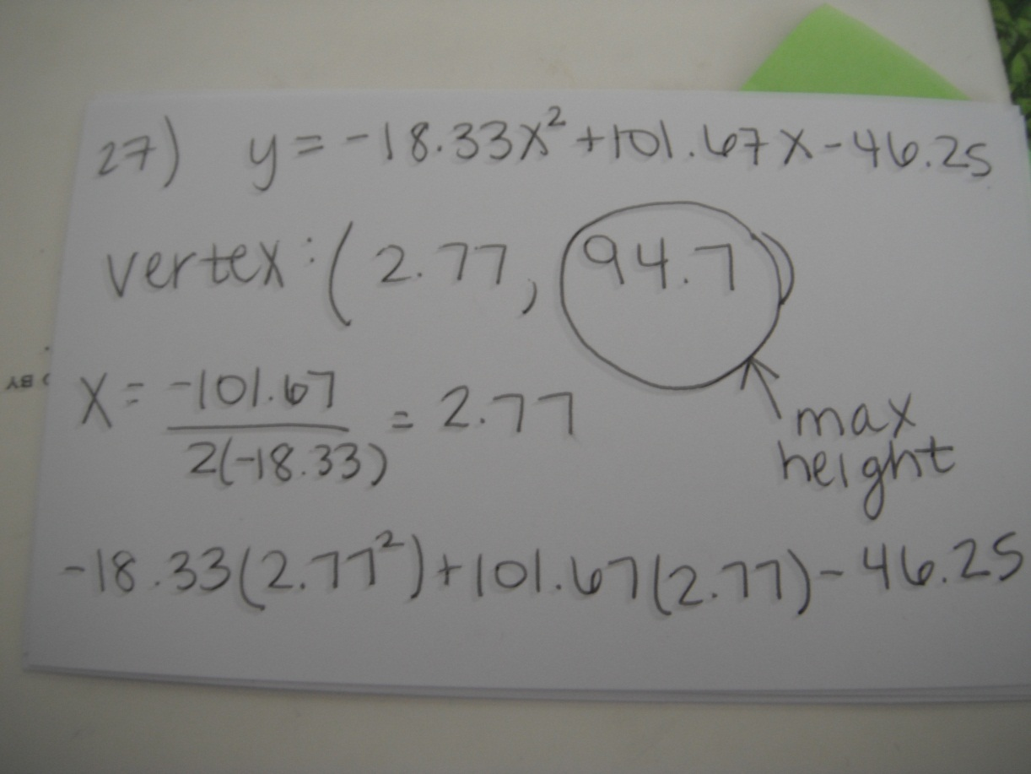
27. This scatter plot shows the height, in feet, of a ball launched in the air from an initial height of 3 feet, and the time the ball traveled in seconds.
Based on an estimated quadratic regression curve, which is the BEST estimate for the maximum height of the ball?

Slide 8
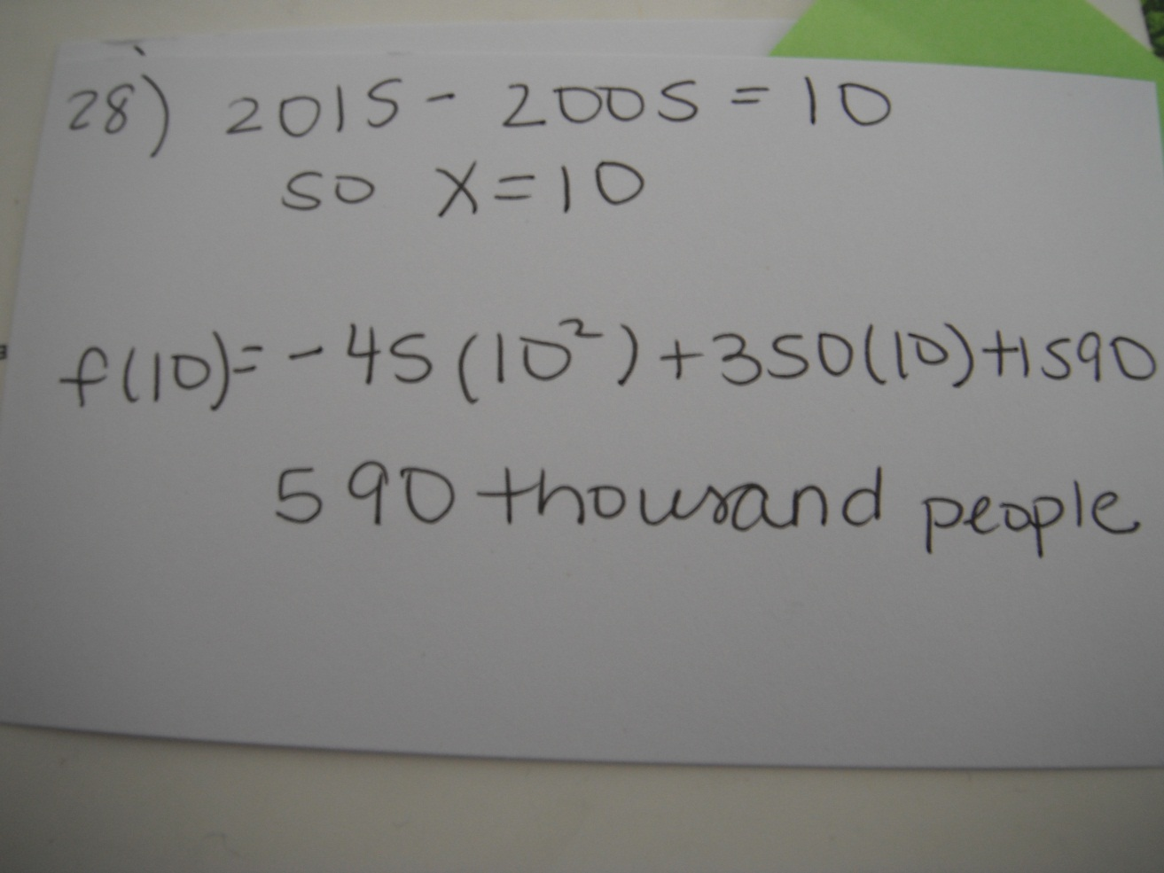
28. The quadratic function f (x) = -45x²+ 350x +1,590
models the population of a city, where x is the number of years after 2005 and f(x) is the population of the city in thousands of people. What is the estimated population of the city
in 2015?

Slide 9
29. Annie is framing a photo with a length of 6 inches and a width of 4 inches. The distance from the edge of the photo to the edge of the frame is x inches. The combined area of the photo and frame is 63 square inches.
a. Write a quadratic function to find the distance from the edge of the photo to the edge of the frame.
b. How wide is the photo and frame together?

